Slide 1


Slide 2
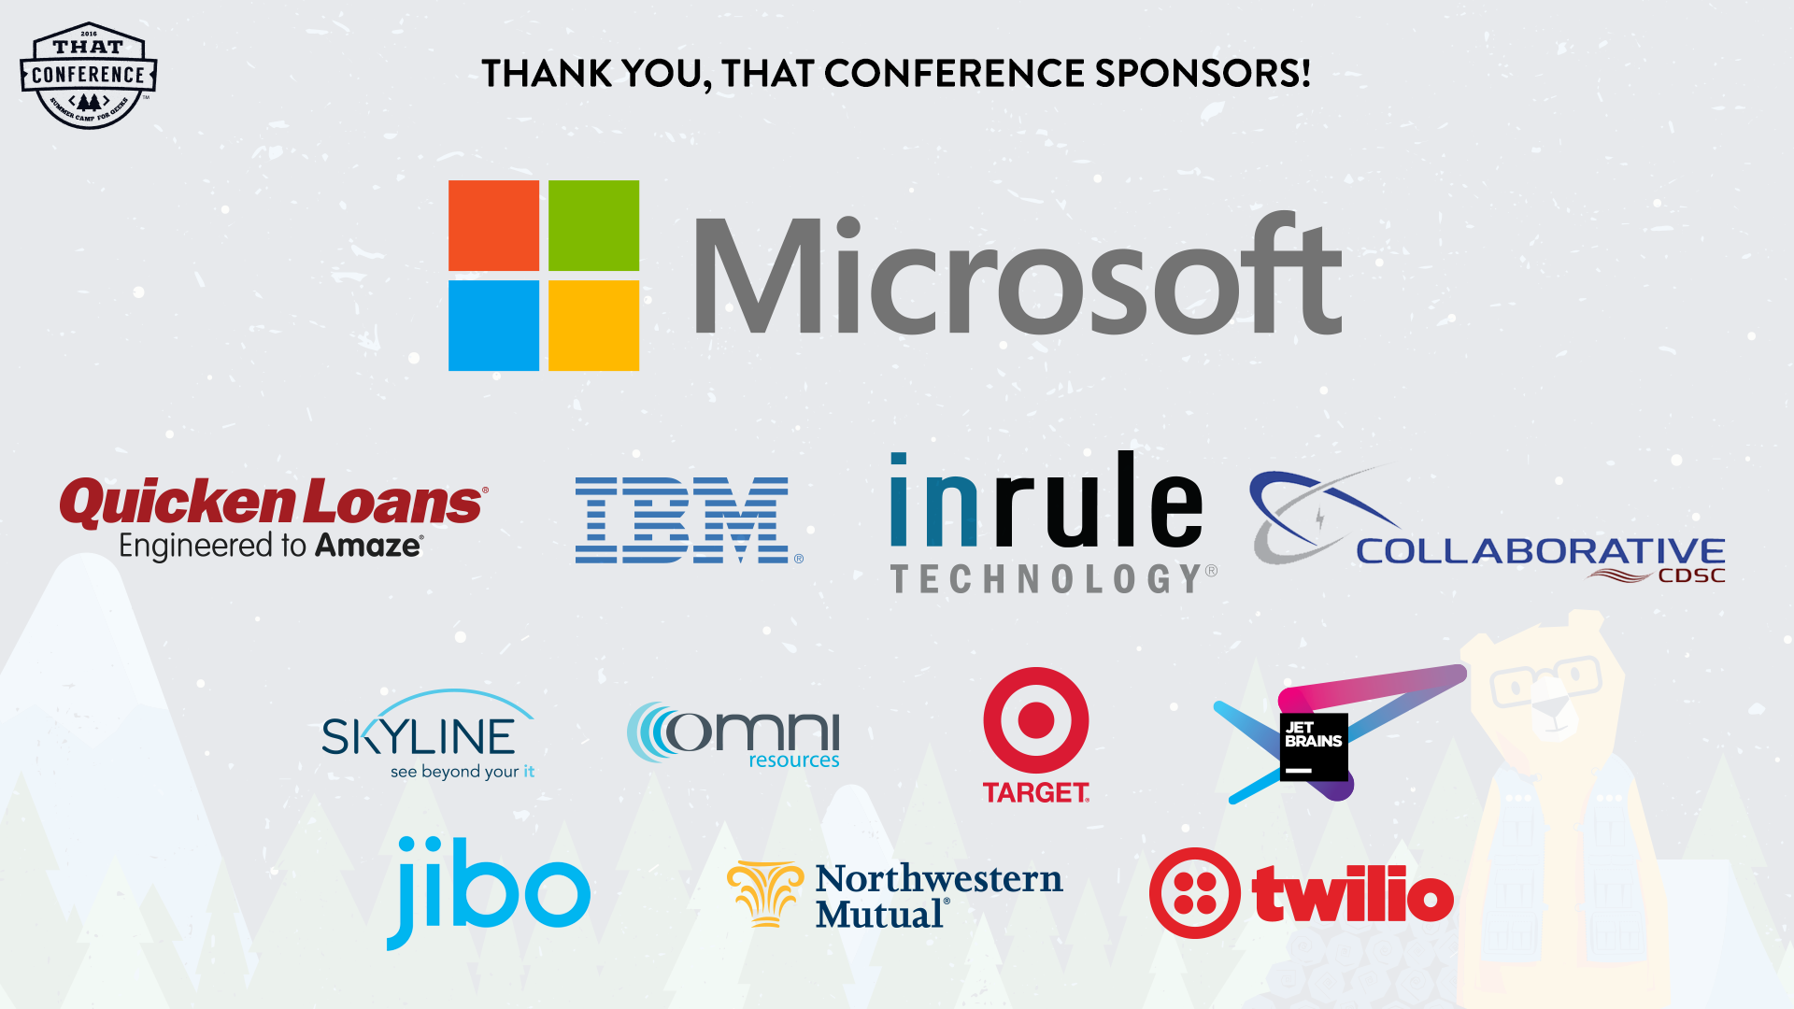

Slide 3
Boost your Immune System with DevOps
By Michelle Munstedt
Quality Assurance Architect, J.J. Keller & Associates, Inc.
Notes:
Today I’d like to share with you some of my journey in learning what it means to test under DevOps. I remember back when my team was first figuring out just how we were going to implement DevOps. I was trying to wrap my head around this idea of moving a build through a deployment pipeline, from the point of checking in code to the point of whooshing it off into Production, and specifically trying to understand where testing was going to occur along the way. So, I asked my manager if he could describe the process for me. And he said “Sure, let me draw it out on the whiteboard.” Well, as I recall, that picture looked something like this….

Slide 4

Looking Back…
My Intro to Testing under DevOps
Notes:
Looking Back
Of course my head was spinning at the time, and I was feeling a little woozy, so I grabbed this snapshot for future reference. Well, today I hope to paint a clearer picture for you of what it means to perform testing under DevOps.

Slide 5
Overview
What is DevOps
Evolution of testing
Software Immune System
Myths of Testing under DevOps
Show and Tell
Tips for Success

Slide 6
What is DevOps?
DevOps
Dev + Ops working together
Continuous Deployment
Infrastructure as Code
Cloud Deployment
Notes:
So, first, What is DevOps? Classic definition is Dev and Ops working together. We hear the term “DevOps” all the time, and it means various things to various people. Some may say their Development and Operations teams work well together, so they’re doing DevOps. Others may say they are doing Continuous Deployment, so they must be doing DevOps. Or they have Infrastructure as Code, so they are doing DevOps, or they are deploying to the Cloud, so they are doing DevOps. But DevOps is more than any one of those things. DevOps is more than just a change in process. It is a change in thinking that affects all that we do. The idea of teams working hand in hand that previously were at odds requires a culture change.

Slide 7

DevOps Is…
A culture based on Agile principles
Agile on steroids
Notes:
That’s why DevOps I think is best described as a culture based on Agile principles. But it’s more than just the same old Agile of yesterday. DevOps incorporates many Agile principles, but then applies them to areas outside just the development team. Agile ideas are applied to the design of Operations processes, deployment processes, even the process of creating the software infrastructure. And so DevOps has also been called Agile on steroids.

Slide 8
Common devops practices
Automated provisioning
Continuous build
Continuous integration
Continuous delivery
Automated release management
Incremental testing
Notes:
Now, there are many common practices that occur with DevOps. Here I’ve listed some of the key ones. I don’t have time today to talk about every one of these. My focus will be mostly on this last one, Incremental Testing. But I do want to spend some time first discussing continuous delivery. Because the idea of delivering software at a much faster rate than ever before poses significant challenges for testing.

Slide 9
Continuous delivery
Instead of timed periodic releases (quarterly, monthly, etc.), a developed feature is released whenever the business is ready
Challenge: Other features are still under development. No code freeze, no waiting for all features to be complete before release.
Solution: Features can be hidden from users with feature toggles until ready
New Testing Idea: Test not only the new feature, but also confirm that feature toggles are properly hiding incomplete features.
Notes:
The idea of continuous delivery means that instead of having timed periodic releases (like quarterly, or monthly, or whatever), we can release a feature to Production whenever the business is ready. So, once a feature has been developed, there is no need to wait for some arbitrary pre-arranged release date. If the business wants the feature released now, then we release it. Of course that does present some challenge, since we’re continually developing new features. There is no code freeze prior to a release, so releasing that new feature might also mean releasing an unfinished feature along with it. But, that’s OK, for that we use a feature toggle. This allows us to release the new feature with the unfinished features hidden from view. So, what does that mean for testing? The testing role has certainly evolved in recent years. I’d like to highlight how the testing approach has changed under Waterfall, Scrum, and now Continuous Delivery.

Slide 10
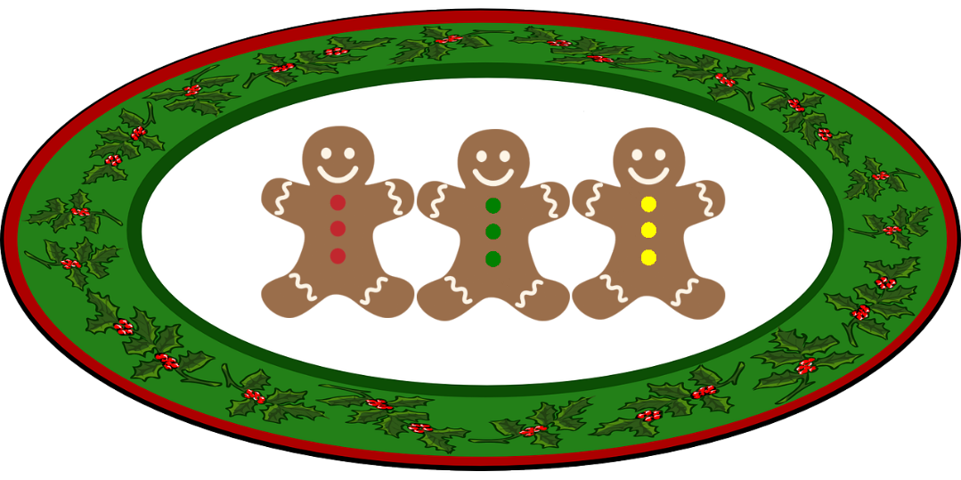
Evolution of Testing: Waterfall
Review all requirements
Write all test cases
Perform all testing
Deliver all cookies
Notes:
First, we’ll take a look at how testing looked under Waterfall. In my analogy here, we can pretend that we are delivering Christmas cookies for a cookie company. If you would, consider each cookie to be like a software feature being delivered.
Review all requirements, Write all test cases, Perform all testing, Deliver all cookies.
This entire process could take months.

Slide 11
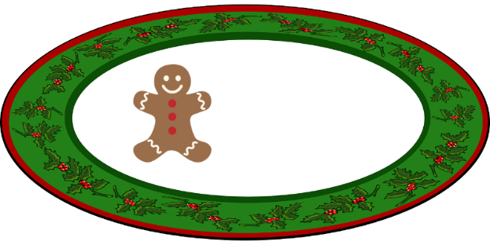
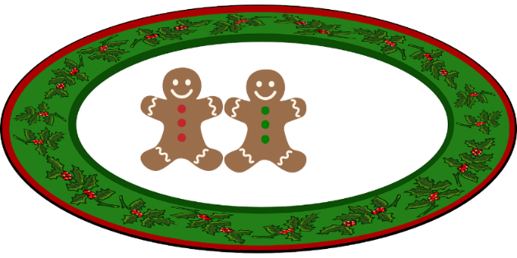
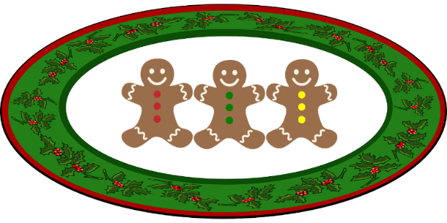
Evolution of Testing: scrum
Review requirement for Cookie 1
Write test case for Cookie 1
Perform testing for Cookie 1
Deliver Cookie 1
Review requirement for Cookie 2
Write test case for Cookie 2
Perform testing for Cookie 2
Deliver Cookie 2
Review requirement for Cookie 3
Write test case for Cookie 3
Perform testing for Cookie 3
Deliver Cookie 3
Notes:
Then along came more agile processes like Scrum. Businesses decided they didn’t want to wait months for cookies to be delivered, so we divided the work into iterations, typically 2 or 3 weeks, so that at the end of each iteration, a new cookie was delivered.
Review requirement for cookie 1, write test case for cookie 1, perform testing for cookie 1, deliver cookie 1. Repeat for cookie 2, cookie 3.

Slide 12
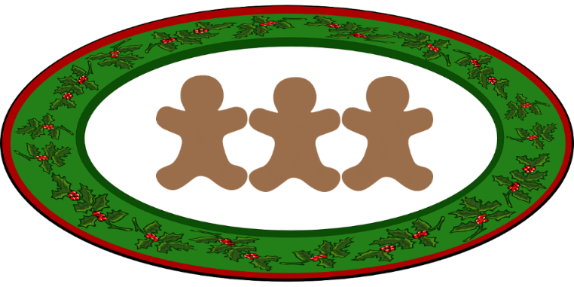

Testing with Continuous DELIVERY
Bake cookies, test, deliver
Cookies are not decorated yet, so hide them with a feature toggle
Notes:
Now, things are a little different under Continuous Delivery. We might not deliver finished cookies at all.

Slide 13
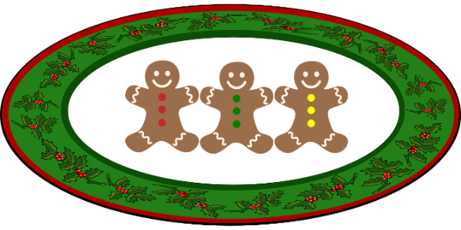

Testing with Continuous DELIVERY, cont.
Decorate the cookies, test, deliver
It’s not party time yet, hide the cookies!
(Feature toggle)
Party time! Bring out the cookies!
(Remove feature toggle)
Notes:
I’ve shown 2 ways that feature toggles might be used. First, they could be used to hide incomplete features. But they can also be used to hide features that are complete, but where the business doesn’t want to reveal that new feature just yet.

Slide 14
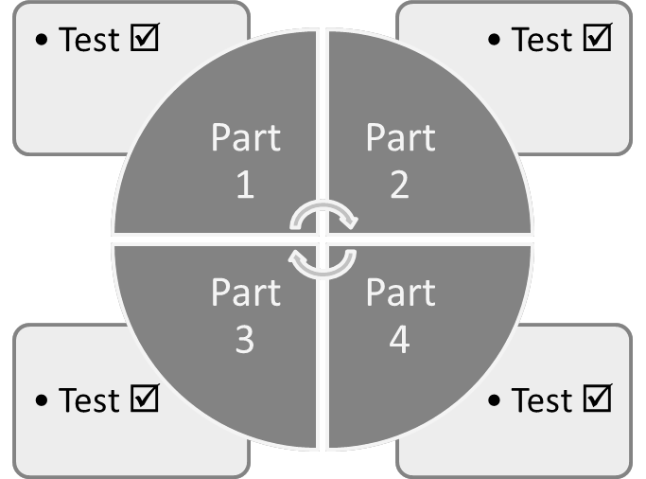
What to test
Incremental Testing
Regression Testing
Test each part
Regression Test after each part
Add Part 1
System Test
System Test
System Test
System Test
Add Part 4
Add Part 2
Add Part 3
Notes:
As we are looking at our testing strategy under Continuous Deployment, there are really 2 areas of focus. Under our past methods of Waterfall or Scrum, we would develop several complete features, then go through a regression testing phase, then release to Production. But under Continuous Deployment, we might release to Production after each part of a feature is developed. We need to regression test with each release, so this means running those regression tests more often than before.

Slide 15

So much testing!
Continuous deployment requires frequent regression testing. How will we find the time?
Work longer hours?
Hire many more QA?
OR
Find a way to make the system do the testing for us!
Notes:
All of that testing can be overwhelming. For example, someone releasing to Production quarterly might conduct regression testing once every 3 months. When implementing Continuous Deployment, you might need to conduct that regression testing 10 or 100 times more often! Where will we find the time to do all that testing?
At this point some of you are thinking “Oh, this is where she starts talking about automated testing!” Well, yes, and no…..because just having some automated tests is not enough to really solve our problem.

Slide 16
Having automated tests is not enough
Why?
Who is going to run the tests?
When are the tests going to be run?
Consider this Scenario:
Test new feature
Fix defects
Regression test
Notes:
Why? Automated tests are fast, right? Isn’t that all we need?
Who is going to run the tests?
When are the tests going to be run?
QA receives a new complex feature to test. The QA dives in, and proceeds to log 30 awesome defects. After multiple rounds of developer fixes, and re-fixes, and testing, and re-testing, the feature looks good. OK, then, time to run all those system regression tests. So, QA first spends time to get the automated regression test system ready, sets up test data, and kicks off the test. And what happens? Uh oh. In order to add the new feature, some common code was modified, and now we find out that core functionality is no longer working. The new feature will need to be pulled out and redone. So all those defects logged were for nothing.
So what went wrong here? We had automated tests. First, QA had to spend time setting up and running the tests. Then, we found out a major problem, but late in the process. It would have been better to have found that out sooner! Clearly, something needs to change in this process if we want to be able to release software on a frequent basis. We need a new system.

Slide 17
Testing system wish list
I wish my system would:
Run automatically
No data setup/teardown
Find bugs early
Find bugs in critical areas first
Run quickly
Notes:
When designing something new, I like to look at existing systems that are already been used successfully. So, why not take a look at a system that has been successfully managing bugs for thousands of years? Let’s take a look at the human immune system and see if there might be some characteristics that we can apply to our own testing system.

Slide 18

HUMAN IMMUNE SYSTEM: AUTOMATIC
Is automatically triggered in response to pathogens
We don’t even have to think about it!

Slide 19
HUMAN IMMUNE SYSTEM: multiple layers
Immune System
External
Skin
Mucous Membranes
Internal
Organs
Hair
Tissues
White Blood Cells

Slide 20
HUMAN IMMUNE SYSTEM: Segregation of duties
Multiple types of cells with specific jobs
Leukocytes
Phagocytes
Lymphocytes
Neutrophil
B Cells
T Cells

Slide 21
Human immune system: innate and adaptive immunity
Innate Immunity
Always present (ready to attack)
Rapid response
Dendritic cells, Mast cells, Macrophage
Adaptive Immunity
Stimulated by exposure to a microbe
Slow response
T cells, B cells
Notes:
Our first response to pathogens is our innate immunity. This level consists of our body's defenses which are always present and ready to attack. Our immune response evolves over time. Once we are exposed to a pathogen, our bodies remember the pathogen and create antibodies which will be ready to attack should we ever be exposed to that pathogen again.

Slide 22


Human Immune System: feedback
We continuously receive feedback from our immune system regarding the state of our health
I feel good!
I feel bad!
Notes:
The human immune system has been doing a great job for us for thousands of years. Let’s see if we can apply the same principles to a software immune system.

Slide 23
Key Characteristics OF HUMAN IMMUNE SYSTEM
Automatic
Multiple Layers
Innate Immunity
Adaptive Immunity
Feedback
Segregation of Duties

Slide 24
SOFTWARE IMMUNE SYSTEM: AUTOMATIC
Automated Builds
Automated Release Management
Automated Testing
Automated Monitoring

Slide 25

Software immune system: multiple layers
CI
Dev
QAS/Staging
Most critical tests Least critical tests
Key:
= Quality Gate
Notes:
So what does it mean to divide our testing into layers? Well, it means I’m not going to conduct all of my testing all at once, in one build or one environment. I’m going to divide it up. Remember back to our Wish List, where we identified that we want to find bugs in critical areas of the system first. So, I’m going to run my critical path tests first, and the least critical details are tested last. You might ask why does it matter whether I test the most critical tests first or last? Well, testing takes time. I don’t want to spend a bunch of time testing little details in a build, and then find out there is a defect in a critical path of functionality. In that case, it would have been a waste of time to test those details. As soon as I find a defect in the critical path, I send it back to the developer to be fixed. At that point I’ve proven that the build is not a viable release candidate, so I don’t spend any further time with it. The developer must check in new code to fix the problem, which triggers a new CI build, and that build can then progress through our deployment pipeline. When a build is created, it passes through a series of quality gates. The build must pass tests at each level in order to be promoted to the next step in the pipeline. If the build fails a test, then it is not promoted to the next level. You might notice that there is even a quality gate before the CI build is even created. That represents our build and unit tests that are run and must pass before the CI build is deployed. As the build progresses through these levels, our confidence in the build increases, and so at each stage we are willing to invest more time in testing the build. With each level, the tests we run become more detailed.

Slide 26
Software immune system: segregation of duties
No!
Yes!
The marathon test
Many small tests that run independently and simultaneously
Test
Test
Test
Test
Test
Test
Test
Test
Test
Test
Test
Test
Test
Test
Test
Test
Notes:
Divide your suite of tests into many subsets of tests that can be run independently. Allows tests to be run simultaneously, resulting in faster overall runtime of tests. (We have 54 groups of regression tests)

Slide 27
Software immune system: innate and adaptive immunity
Innate Immunity
Tests are automatically run
Adaptive Immunity
When defects are found, tests are updated, to catch the problem faster next time
Tests run immediately after a build

Slide 28
Software immune system: feedback
The Goal of Testing is to provide feedback to the business so they can decide at any point in time whether to release the current build or not.
The Goal of Testing is not to find bugs!
Business needs to know the good and the bad in order to make a fully informed decision
Feedback comes at all levels: CI, Dev, QAS, Production
Notes:
Some might be surprised to hear that the goal of testing is not to find bugs. I’ve even heard QA folks say that their goal is to find bugs, and if they test for an entire day and find no bugs, they go home feeling like a failure. But they are overlooking the value they provided in discovering the health of the system. That’s valuable information for the business.

Slide 29
Human vs. software immune systems
Characteristic | Human | Software
Automatic | ✓ | ✓
Multiple Layers | ✓ | ✓
Segregation of Duties | ✓ | ✓
Innate Immunity | ✓ | ✓
Adaptive Immunity | ✓ | ✓
Feedback | ✓ | ✓

Slide 30
Wishes granted!
Each wish is granted by a characteristic of the Software Immune System:
Wish | Characteristic
Run automatically | Automatic
No data setup/teardown | Automatic
Find bugs early | Innate Immunity
Find bugs in critical areas first | Multiple Layers
Run quickly | Segregation of Duties

Slide 31
Myths of testing under devops: Myth #1
Myth
Every changeset is immediately deployed to Production
Reality
Only changesets which pass automated tests are released to Production

Slide 32
Myths of testing under devops: Myth #2
Myth
Features are released to customers without testing
Reality
Builds must pass through all quality gates in the pipeline before release
We choose which features to show using feature toggles

Slide 33
Myths of testing under devops: Myth #3
Myth
No manual testing occurs under DevOps
Reality
Teams choose the type of testing that is necessary.
Most teams use a combination of manual and automated testing

Slide 34
Show and tell
Enough theory...what does all this look like in the real world?
Let's look at:
Deployment Pipeline
Release Management
Types of Tests
Monitoring

Slide 35
Deployment Pipeline
CI
Build and Unit Tests
System Availability Smoke Test
Dev
Functional Smoke Test
QAS
Detailed Smoke Test
Detailed Regression Tests
Prod
Continuous Monitoring
Notes:
Quality gates between each step

Slide 36
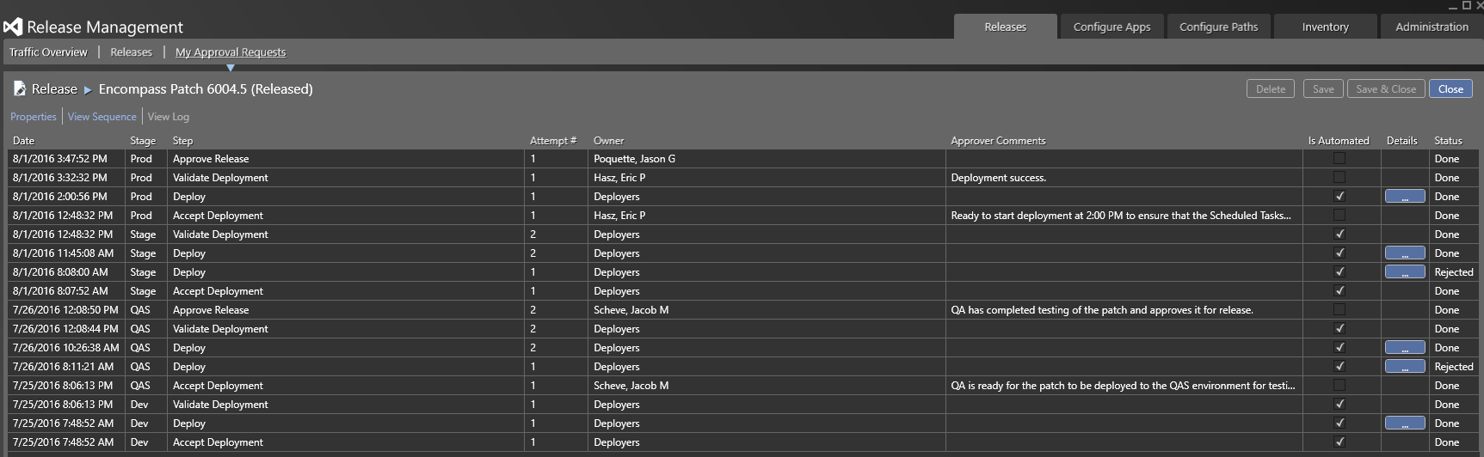
Release Management
We use Microsoft Release Management to orchestrate our releases
Notes:
This is a screenshot of a release we put out recently. You can see how the build progressed through each stage of Dev, QAS, Stage, Prod. The MRM tool allows us to orchestrate the entire release, kicking off automated build and test scripts along the way. We have a could of manual approval points included in our process as well, where QA confirms that the release looks good to go. Now we have an auditable trail of our release process.

Slide 37
TYPES of Tests
Automated Smoke Tests
Manual Tests
Automated Regression Tests
Unit Tests
Notes:
Let’s hop over to our Jenkins build server and take a closer look at the automated tests. DMO CI, DMO Dev, DMO QAS, Regression, KMB demo. Demo of CI System Availability Smoke Test on Keller Mobile. (Showing that this process applies to mobile applications too!)

Slide 38
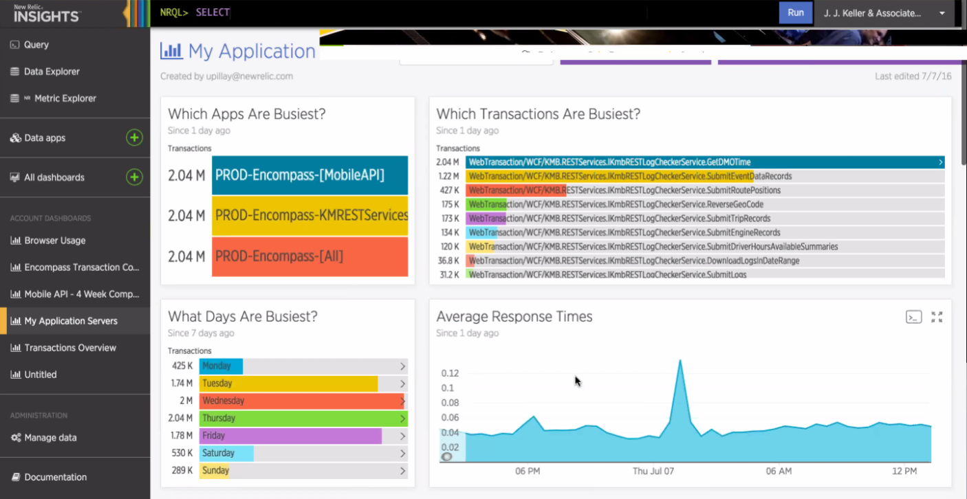
monitoring
Notes:
We use New Relic for monitoring our sites in Production

Slide 39

Where to Start?
A few tips…
Notes:
Maybe you’re looking at all of this thinking this looks rather complicated, and you’re not even sure where to start. Let me share some tips for implementing a software immune system.

Slide 40
Tip #1: automated smoke test
Small Investment
Frequent Feedback
Great ROI
Start with a smoke test

Slide 41
TIP #2: Use VM’s
Create VM with test data
Run test
Delete VM if test passes
Notes:
Use VMs so that many tests can be run simultaneously. This also allows you to remove data setup and teardown steps from your tests. The VM’s can be set up with a specific set of data, restored from a known database, then the test can be run. There is no need to clean up the data after the test, instead just delete the VM. But notice I say delete the VM only if the test passes….

Slide 42

TIP #3: Plan for Failure
Keep VM if test fails
Plan for time for a human to evaluate test results
Notes:
When the test fails, it is useful to keep the VM in the state it was in when the test failed. This helps the QA troubleshoot the issue. Realize that tests may fail due to an actual defect of software, or could fail because the software has changed but the test needs to be updated. A human will need to review the test failure and determine why the test failed. Plan for spending this time.

Slide 43
TIP #4: Be Selective about what to automate
Do not automate every test from the manual test plan
Automate only critical path scenarios
Notes:
Be selective about what to automate. At first it will be tempting to simply automate every test from the manual test plan. Over time though, test suite will become very large. Consider the amount of time required to create the test, maintain the test, and run the test. When manually testing, we might have test cases for boundary conditions for example. We want to make sure a date field only accepts properly formatted dates. So, in manual testing, we might try entering in letters, or the number 13 for the month or things like that. But is that a test we need to automate? What is the likelihood that a year from now this field will no longer maintain its date formatting? And further, if it were to fail, would anyone care? If someone enters the letter z for the characters in a date, and the system doesn’t stop them from doing it, would the product owners be concerned enough to stop developing some new feature in order to fix this issue? If you think not, then don’t bother automating it. As a rule of thumb, consider one critical path scenario to automate for a new feature. If you have written acceptance criteria, that would be a place to look for that scenario. Sometimes one scenario is not enough, and you might determine there are 2 or 3 critical paths that absolutely must be included in the automated test, and that’s fine. The point is to be selective, and not automate everything under the sun.

Slide 44

Questions?
Notes:
That brings me to the end of my presentation today. I hope you enjoyed it. Any questions?

Slide 45

J.J. Keller giveaway
Easy entry to the J. J. Keller Giveaway!
Take and post a pic and say something about J. J. Keller – include #JJKDevs and #ThatConference
Multiple posts per day allowed!
Stop by our sponsor table to play with our VR tech and for more chances to win!

Slide 46


